Slide 1

Particle Swarm Optimization
CL603 Project - Team Ascenters
Abhi Manjunath (190020036)
Deepak Thorat (190020037)
Mihir Nandawat (190020071)
Image Source

Slide 2
Table of Contents
Introduction
Algorithm
Literature Survey
Approach Overview
Problems - Convex, Non Convex, Constrained
Effects of Hyperparameters
Remarks
Conclusion
References

Slide 3
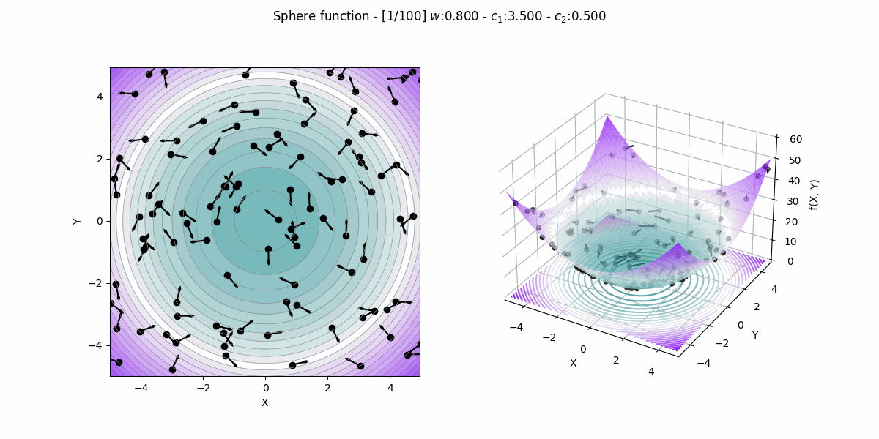
Introduction
PSO algorithm works by having a population (called a swarm) of particles
Each particle has a position and velocity ∊ R^n. Simple mathematical relations describe movement of particles in search space
Particle’s movement is guided by its own best-known position so far (pBest), as well as the best-known position of the entire particle population (gBest)
Process repeated in the hopes of finding a satisfactory solution, but it is not guaranteed
Generally suitable for a class of optimization problems which are high dimensional and where high accuracy isn't required
Source - PSO TDS

Slide 4
Velocity Update Formula
Influence of particle’s previous velocity
ω - Inertia Weight
Influence of distance between particle’s best known position and current position
C1 - Cognitive Learning Factor
Influence of distance between Swarm’s best known position so far and particle’s current location
C2 - Social Learning Factor

Slide 5
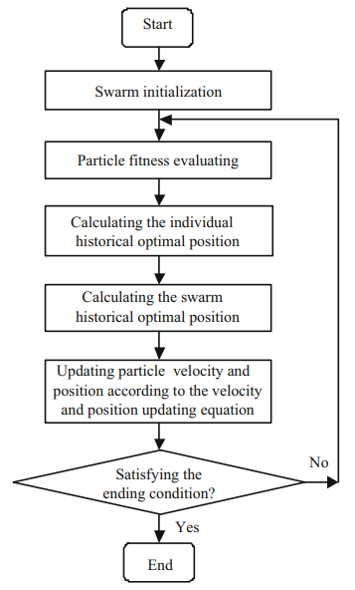
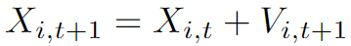
Algorithm
V_{i,t+1} = w*V_{i,t} + c_{,1}*rand*(pBest_{i,t} - x_{i,t}) + c₂*rand*(gBest_{t} - x_{i,t})
X_{i,t+1} = X_{i,t} + V_{i,t+1}
Hyperparameters
W → inertia weight
C₁ → Cognitive Learning Factor
C₂ → Social Learning Factor
Source - PSO Algorithm

Slide 6
Literature Survey
Variants of Velocity Update:-
Basic Algorithm:
V_{i,t+1} = V_{i,t} + 2*rand*(pbest_{i,t} - x_{i,t}) + 2*rand*(gbest - x_{i,t})
Introduction of weight inertia (w)
V_{i,t+1} = w*V_{i,t} + c_{,1}*rand*(pbest_{i,t} - x_{i,t}) + c₂*rand*(gbest - x_{i,t})
This improved the performance of the algorithm by controlling the extent of exploration and exploitation of particles

Slide 7
Introduction of constriction factor (𝜒)
V_{i,t+1}= 𝜒*( V_{i,t} + c₁*rand*(pbest_{i,t} - x_{i,t}) + c₂*rand*(gbest - x_{i,t}))
Constriction factor ensures convergence and increases convergence rate.
PSO Algorithm Local Version:-
V_{i,t+1}= V_{i,t} + c₁*rand*(pbest_{i,t} - x_{i,t}) + c₂*rand*(pbest_{i,n,t} - x_{i,t})
Instead of tracking the Swarm’s optimal position (GBest), track the optimal location found amongst n particles located in topological neighborhood of the particle

Slide 8
Engineering Applications
Adaptive PSO algorithms are used to track the changes in the dynamic system automatically
Environment-based PSO approach is used to optimise an aggregate production plan model
In wireless sensor networks, PSO is used to optimise performance in terms of the number of alive nodes.
PSO is used in swarm robotics

Slide 9
Our Approach
Convex Optimisation
Non Convex Optimisation
Constrained Optimisation
Effects of Hyperparameter
Applied PSO on simple unconstrained convex objective function
Applied PSO on a unconstrained non convex objective function
Converted constrained optimisation problem into an unconstrained problem via penalty function to apply PSO
Studied the effects of w, c1, c2, X (contraction) on PSO
1
2
3
4

Slide 10
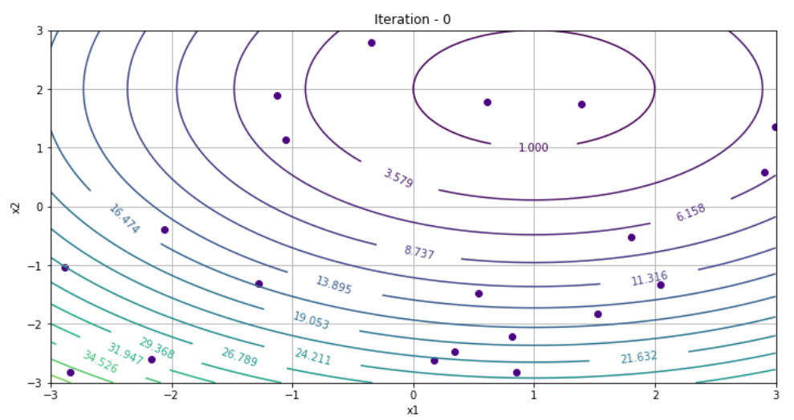
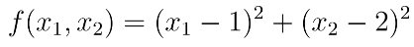
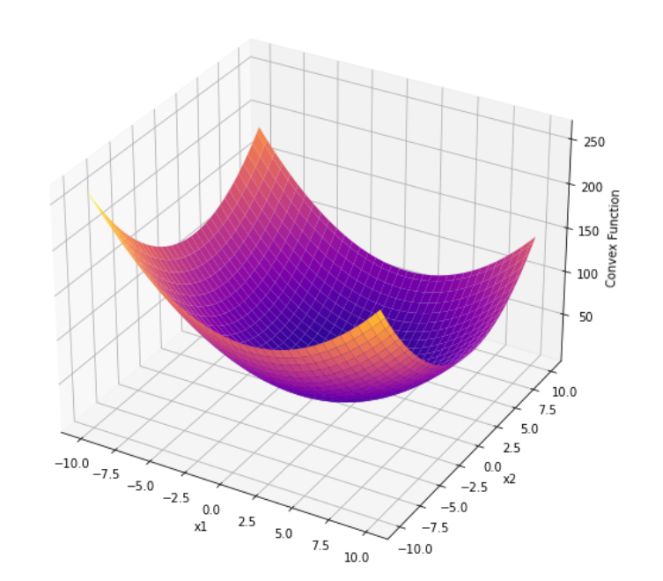
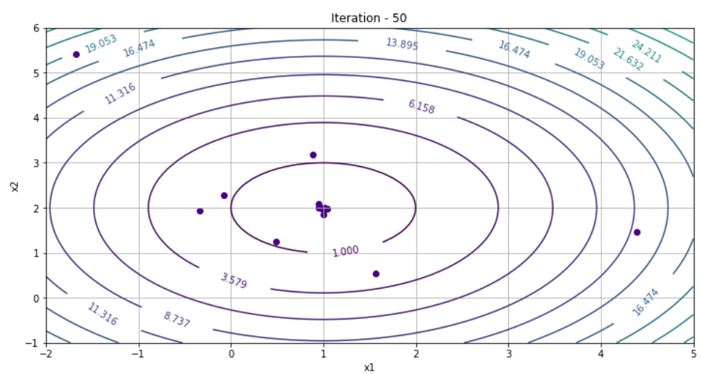
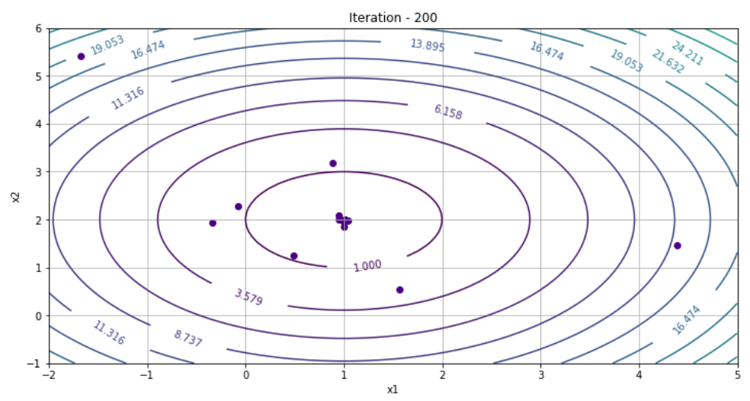
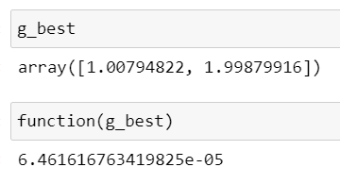
Convex Optimisation
No of Particles - 20
W initial = 0.9 , W := W*0.98
c1, c2 = 2, 2
Iterations - 200

Slide 11
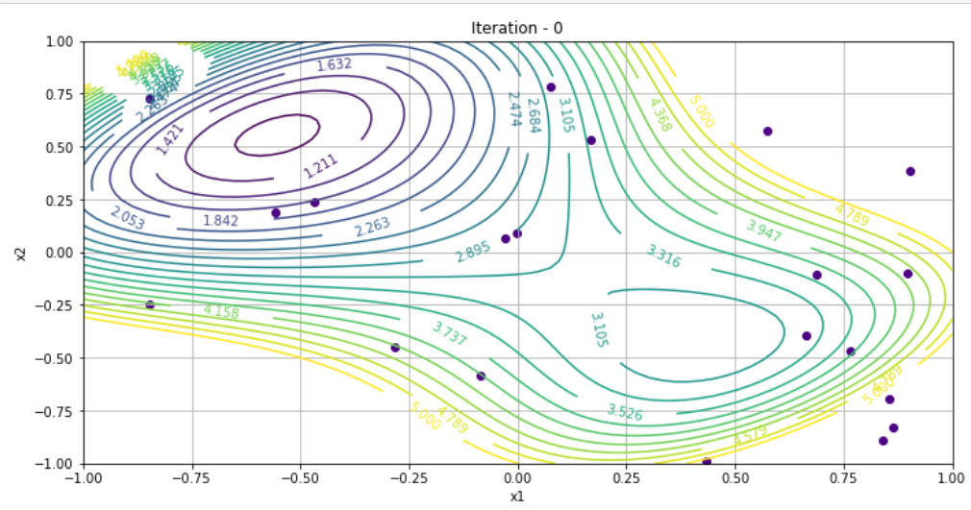
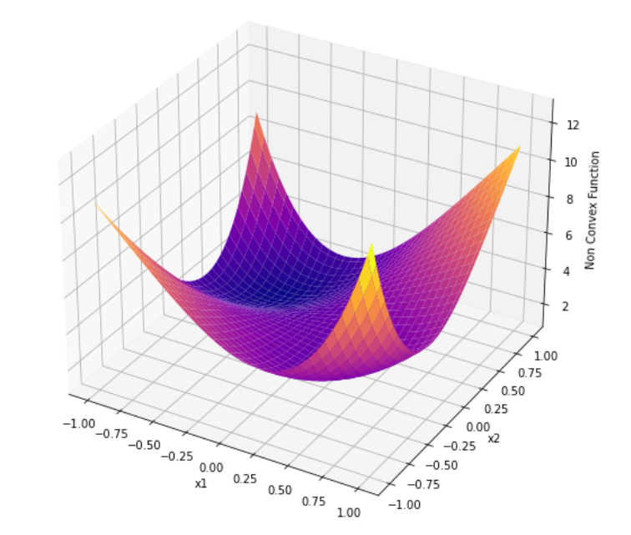
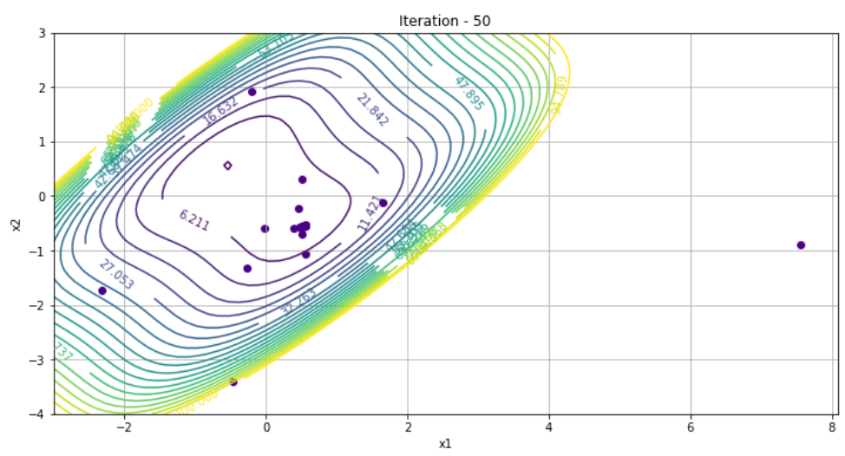
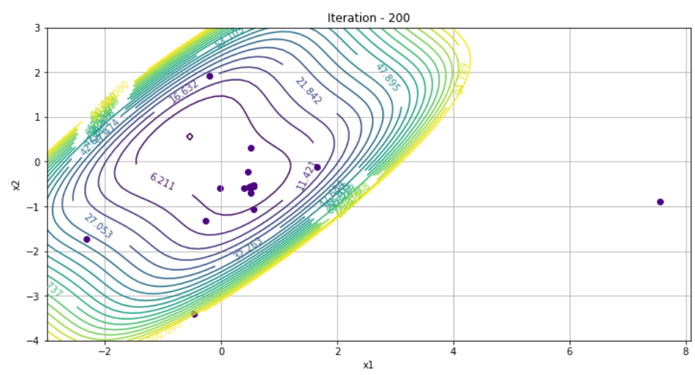
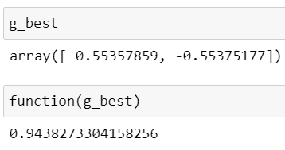
Non Convex Optimisation
No of Particles - 20
W initial = 0.9 , W := W*0.98
c1, c2 = 2, 2
Iterations - 200

Slide 12
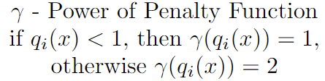
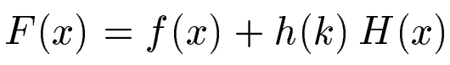
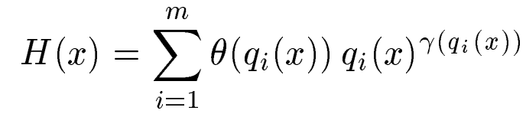
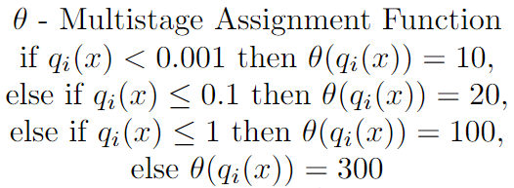
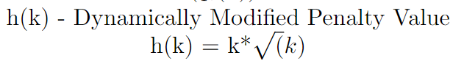
Constrained Optimisation (1)

Slide 13
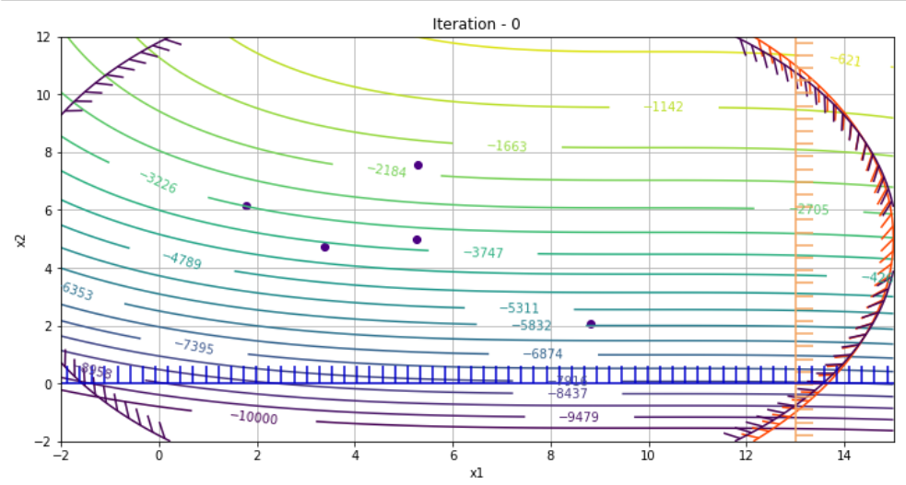
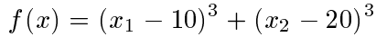
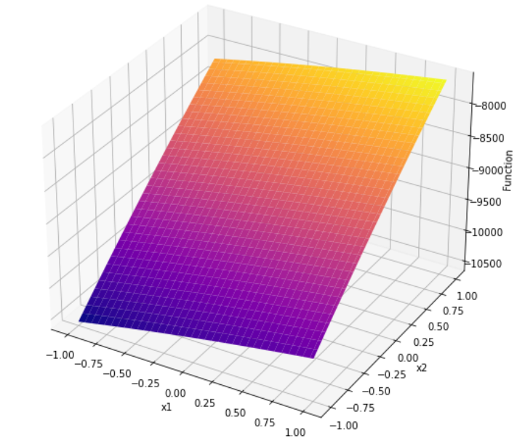
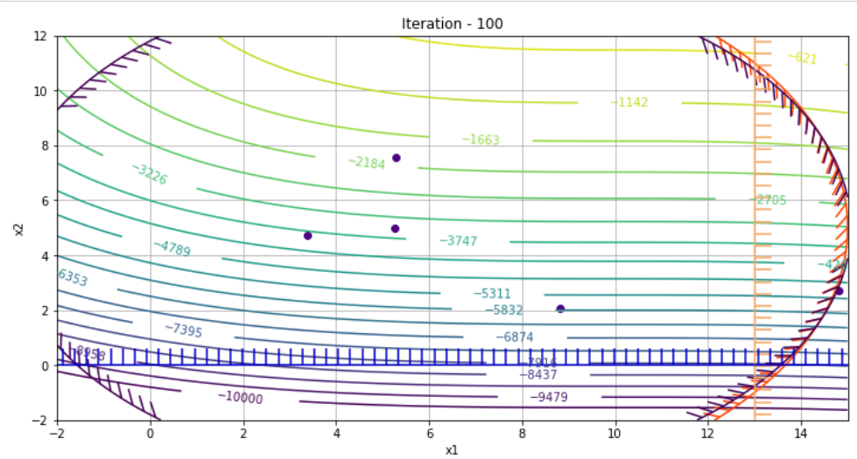
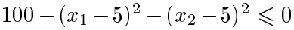
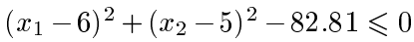
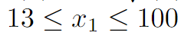
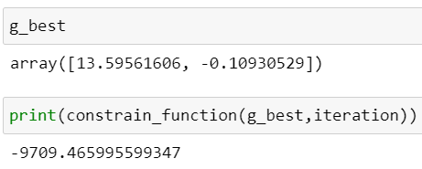
Constrained Optimisation (2)
No of Particles - 5
W initial = 1.2 , W := W*0.98
c1, c2 = 2, 2
Iterations - 200

Slide 14
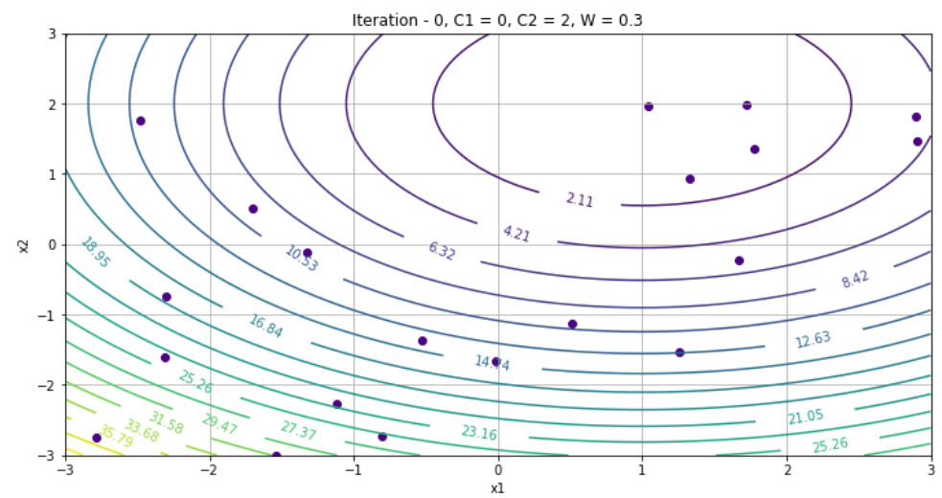
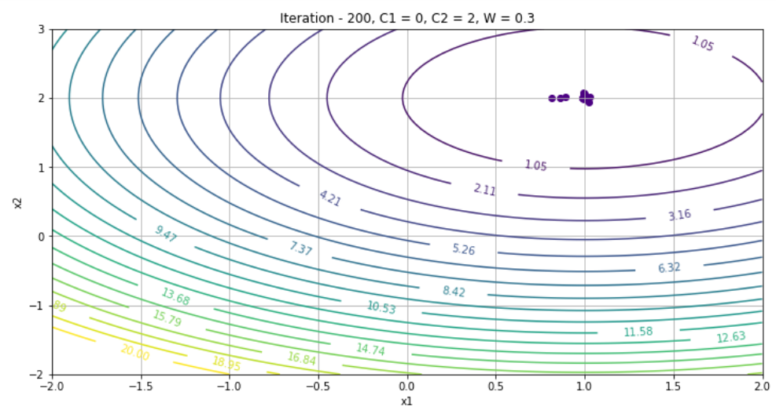
Effects of Hyperparameters (1)
C₁ (Cognitive Learning Factor) - Controls the effect of Particle’s best known location on Particle Velocity
Particles converge at the cost of exploration

Slide 15
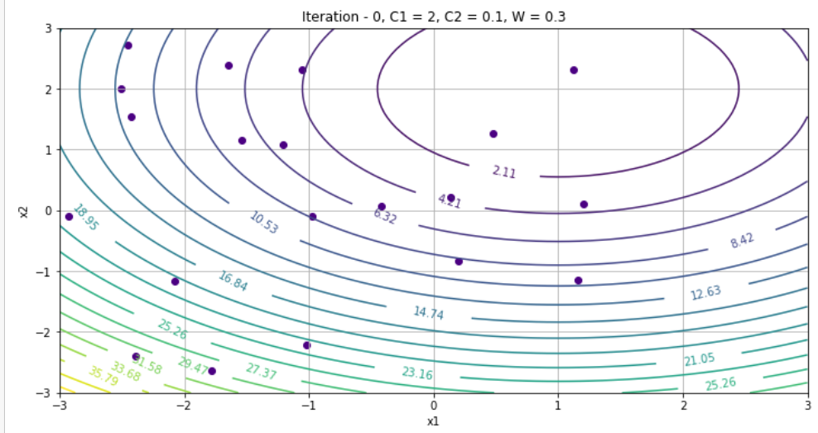
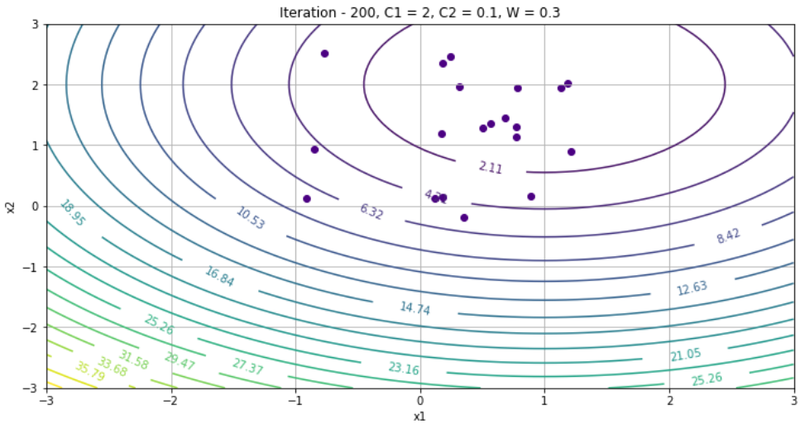
Effects of Hyperparameters (2)
C₂ (Social Learning Factor) - Controls the effect of Group’s best known location on Particle Velocity
Particles do not converge since Exploration ↑ and Exploitation ↓

Slide 16
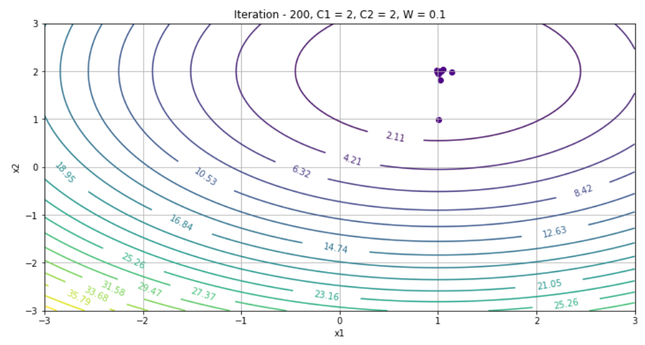
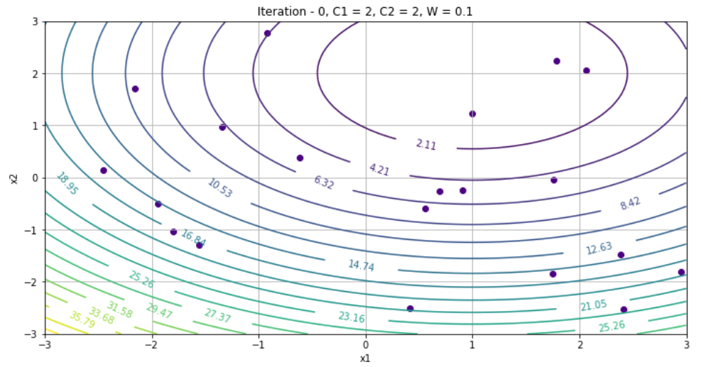
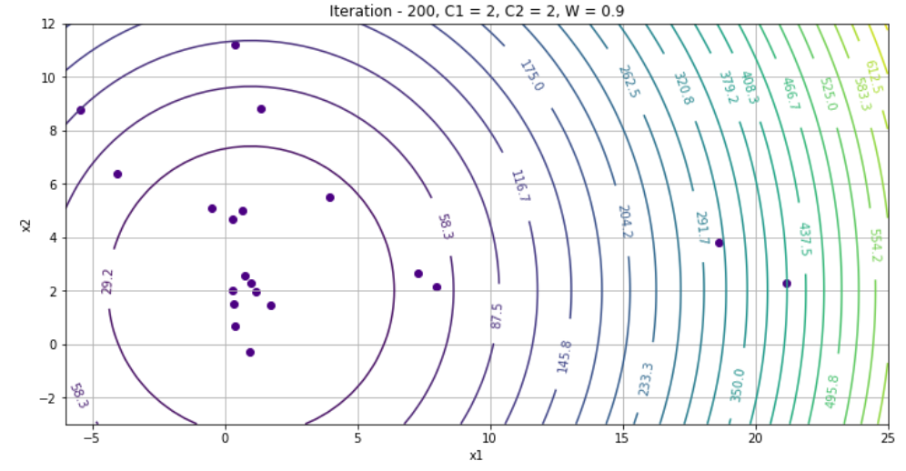
Effects of Hyperparameters (3)
ω (Inertia Weight) - Controls the effect of prev. iterations velocity on the next one
Trade Off between Exploitation and Exploration.
We used W := W*k where k ∊ [0.95,0.98]

Slide 17
Remarks
Potential Further Work:-
Experimentation with different conditional criterias for loop termination other than maximum iterations
Tuning the algorithm’s parameters conveniently and effectively for peak performance
Effective strategy can be build to balance the global explorations and local exploitation

Slide 18
Conclusion:-
Advantages of the PSO algorithm:
Derivative free algorithm
Easy to implement
Limited number of parameters
Less reliance on starting points
Limitations :-
Large possibility of falling into local optimum in high dimensional space
Less accuracy of the optimum solution

Slide 19
References
Particle swarm optimization algorithm: an overview By Dongshu Wang, Dapei Tan, Lei Liu
Particle Swarm Optimization Method for Constrained Optimization Problems By Michael N.
Particle Swarm Optimization Wiki
youtube.com/watch?v=JhgDMAm-imI&t=980s

Slide 20
Thank You

